Slide 1
Process book
Fundraising Duck
Team *Unicorns（Benjamin Stone, Chi Huang, Junhui Yao, Tianying Chen ）
Notes:
Temporary Name

Slide 2
Research
Goal: Design a game to turn single, impulsive transactions into intentional, generous giving.
Initial research
Intentional: Nudging-a technique to have people lean towards prosocial behavior while still giving them freedom to do whatever they want (e.g., check this box if you do not want to be an organ donor ← effective).
Generous: The fewer the barrier, the easier for people to give.
Everyday donors: Commitment device makes people adhere to their promises more.
Online fundraising campaigns: Kony 2012 https://invisiblechildren.com/kony-2012/ (Children)

Slide 3
Prototype One: Design
Adaptation of Monopoly - a board game where you can roll a dice, which determines how many steps you can go.
Example: there’s a flood, you need to more desperately save your animal
Some cards provide you with more info about your non-profit, so you can give a fundraising pitch that is more persuasive
Reward mechanisms
Create item/artifact, ex: bracelet to serve as a reminder about being kind
Reward for giving/being kind
Tell a story/put it in context/roleplaying
Discovery mechanism, every round, you discover more information about the person (or the goal)
Increasing their empathy to help → potentially affect their online donation behavior
Create a campaign in the game
People playing different organizations, competing to raise more money
Some interplay between what one donor can do to the other donor

Slide 4
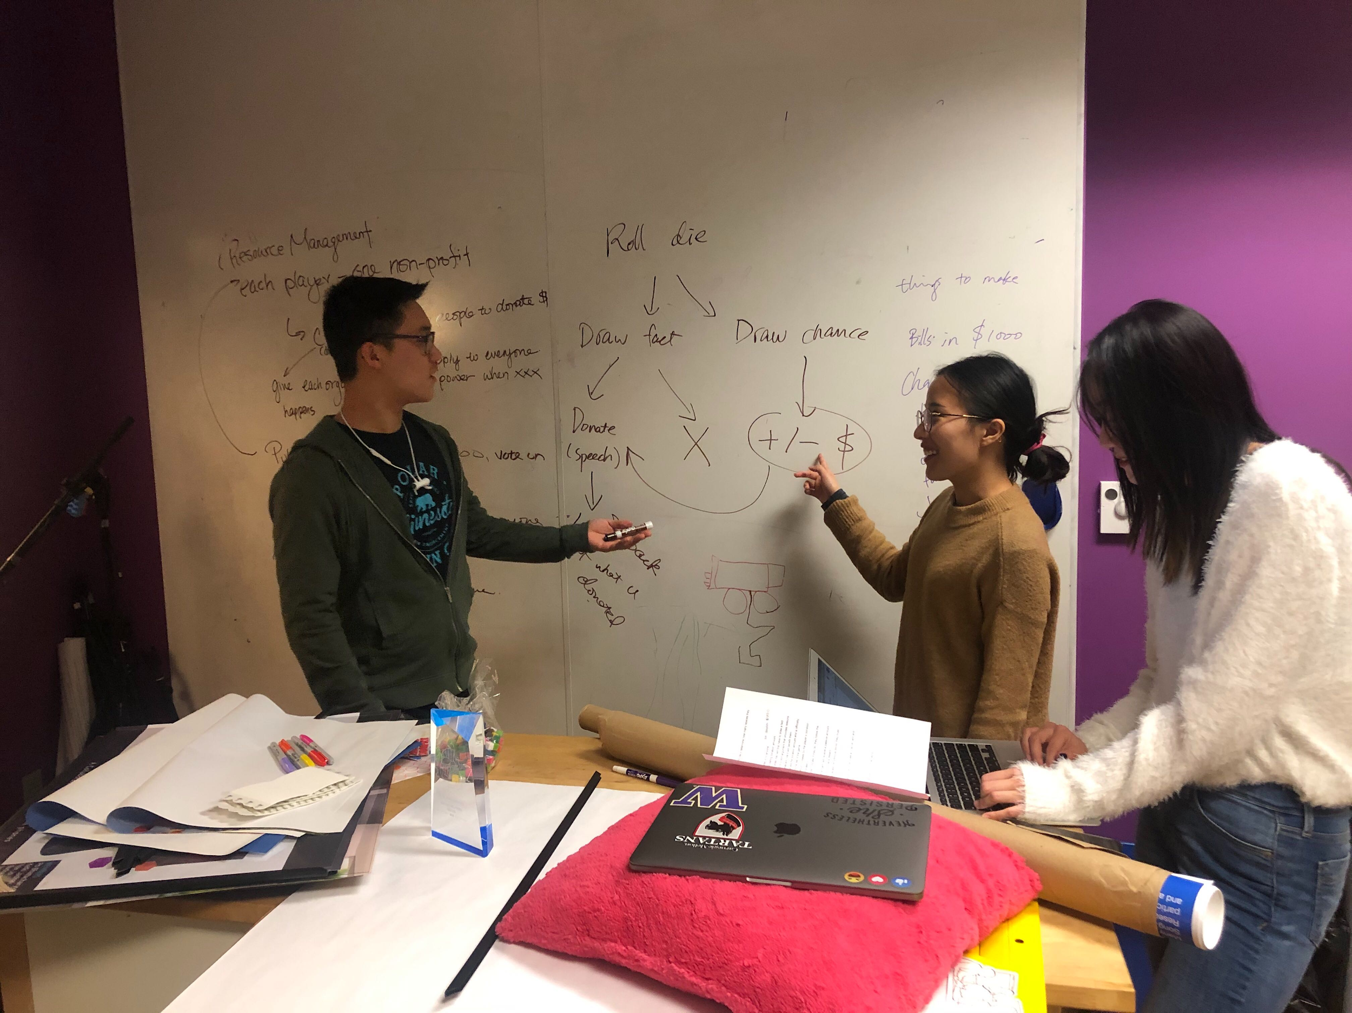
Prototype One: Design

Slide 5
Prototype One: Rules
Players all start on the starting space, and roll a die to determine how many spaces they move forward.
All players start with $10k.
Players can land on three types of spots:
Charities: If the charity has not been landed on by anyone: Each charity will have a starting donation amount. If a player chooses to donate, they will first have to draw a fact card and incorporate it into a pitch/argument that provides reasons of why they want to donate and how it will benefit them. If successful, the player pays the donation amount and is officially a donor of that charity for the rest of the game. The charities’ overall amount increases by the player’s donation. If the charity already has been donated to: The player can still choose to donate; if they do, they follow the previous procedure. The previous donors of the charity will receive a passive amount (breakdown 40%-30%-20%-10%) as a reward. If the player chooses to overtake the previous donor, they must pay a higher donation
Chance: If the player lands on a chance spot, they must draw a chance card and complete the action it describes
Free: Nothing happens The game ends after 7 rounds, and the player with the most money wins

Slide 6
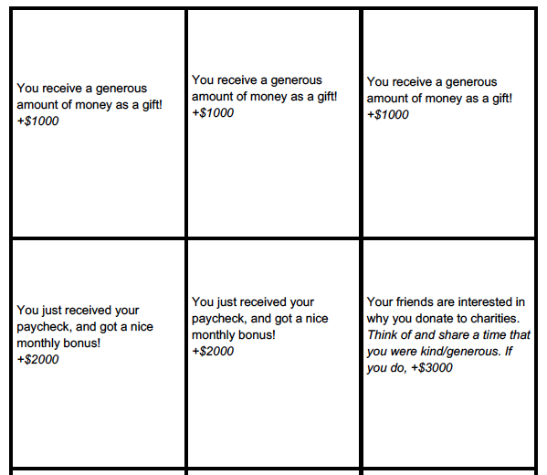
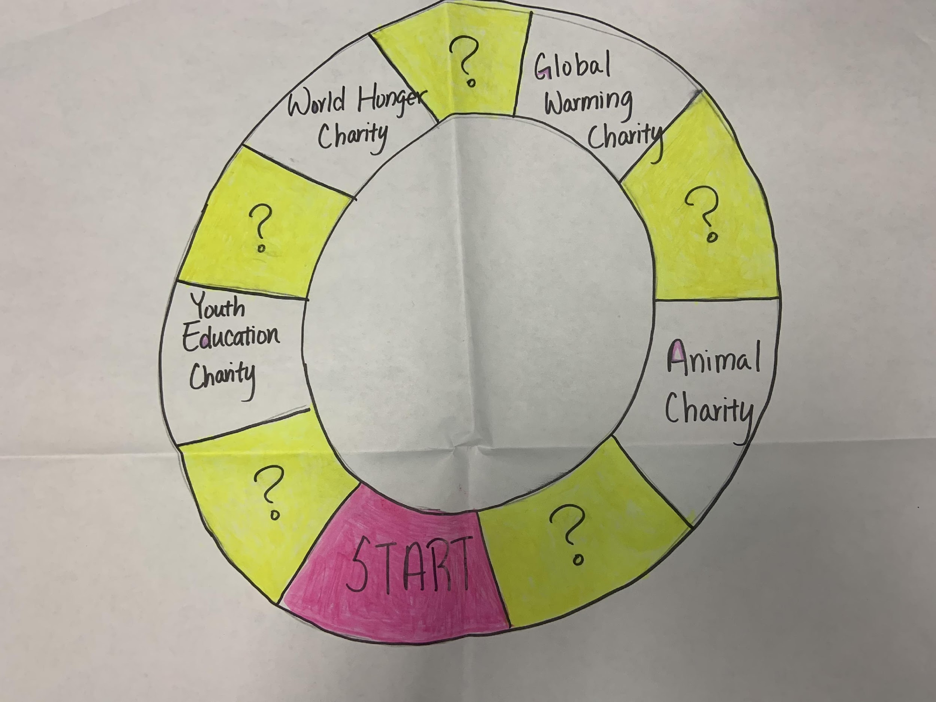
Prototype One: Materials
Fact Cards(Scaffolding for giving a pitch)
Chance Cards
Dice and Game board

Slide 7
Prototype One: Playtest
Feedback:
People who did not donate money wins. (Against intention of encouraging donation).
There was little interaction between players.
When players were asked to give a pitch, they felt pressured and awkward, especially when they don’t have enough information about their own charity.
Players want to have the opportunity to choose their own charity.
Players suggested adding some random elements to the game

Slide 8
Prototype Two: Design
Feedback 1: People who did not donate money wins. (Against intention of encouraging donation).
Add chance cards to encourage donation.
E.g.: Earthquake happened. You need to spend $10,000 to repair your organization.
Rally other organizations to spend to you or you have to pay it all by yourself.
Feedback 2: Interactions should be increased.
We embedded Jackpot into the Chance cards.
We contextualize all chance cards into four campaigns(youth education, hunger, animal protection, global warming).
Feedback 3: Players want to have the opportunity to choose their own charity.
We allowed the players to choose their own charity to play for. This also should increase the knowledge they have for the specific charity they pick.

Slide 9
Prototype Two: Rules
Everyone picks a non-profit (World Hunger Charity, Youth Education Charity, Global Warming Charity, Animal Charity)
if people like the same non-profit, do rock paper scissors
Everyone starts with $10,000 funds when the game starts.
At the beginning of each round, people take turns drawing a card from the chance cards deck and follow the instructions.
Players cannot disclose the amount of money they have unless they drop below $2000.
If any player goes bankrupt everyone loses.
You cannot donate to your own foundation, but you can donate to others.
At the beginning of the game, three special cards will be shuffled into the deck. When all three cards are drawn, the game is over.
The player with the most funds in their foundation wins.

Slide 10
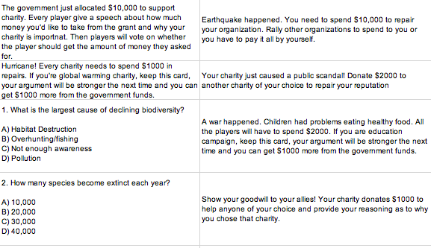
Prototype Two: Materials
Fact Cards(Scaffolding for giving a pitch)
Chance Cards

Slide 11
Prototype Two: Playtest
Feedback
Utilizing pics as a strategy can trigger empathy in people. (storytelling, humor, facts)
Earthquake card changed the direction of the game.

Slide 12
Prototype Three: Design
Feedback 1: Utilizing pics as a strategy can trigger empathy in people. (storytelling, humor, facts)
E.g.: Look at a picture of your respective charity and give a persuasive pitch using the picture. Other players will have to donate at least $1000 to that charity.
Feedback 2: Earthquake card changed the direction of the game.
We changed the mechanism about interpreting the game. Everyone wins if they can survive all rounds with enough money.

Slide 13
Prototype Three: Materials
Fact Cards (Same as previous design)
Pic Cards
Chance Cards (same as previous design)

Slide 14
Prototype Three: Playtest
Feedback
Resources trade-off and joint project will encourage interactions.
Players felt awkward having to prepare a pitch which is the main activity of the game.
Players felt bombarded with the text on the fact sheets.
Having to choose a charity is limiting because players could care about more than one charity.

Slide 15
Prototype Four: Design
Feedback 1: Resources trade-off and joint project will encourage interactions and,
Feedback 4: Having to choose a charity is limiting because players could care about more than one charity.
We added projects in which everyone can donate if they care about the cause. This way players also do not need to choose only one charity to contribute and instead can contribute to as many specific projects as they want.
E.g.: The cancer research as John Hopkins is making a big step forward. However, they are running out of money! If we don't act now there might be another few decades before we find a new treatment! Compete with others to donate to the cause and win tokens of goodwill!
Feedback 2: Players felt awkward having to prepare a pitch which is the main activity of the game.
We reduce the odds of giving a pitch in the game. We introduced silent auction through which, they could get tokens to have their artifacts, in the end, to let people express their goodwill.
Feedback 3: Players felt bombarded with the text on the fact sheets.
We removed the fact sheets. Instead, we incorporated facts into the joint events described in feedback 1.

Slide 16
Prototype Four: Rules
Each player is a donor, and each player starts with $10,000 . They get a bead whenever they contribute to charitable causes.
Different types of chance cards:
Auction: Players have a silent bidding section, the highest bidder gets 4 beads, second and third highest gets 3 and 2 beads, fourth gets 0.
Players don’t reveal how much money they’re going to bid in the moment. After each silent auction, roll the die. Get die number x 1000 of money.
Event: Players follow event instructions listed on the cards. These include events which, for instance, make one or all player lose or gain money. There are also special ability cards.
Quiz: there’s a question with multiple choice. Each player give their answer at the same time. Whoever got the correct answer gets a bead. There is an answer sheet to the questions.
The game ends when all the auctions card runs out and the player that has the most beads win!
At the end of the game, each player could use the beads they have to make them into a keychain or bracelet.

Slide 17
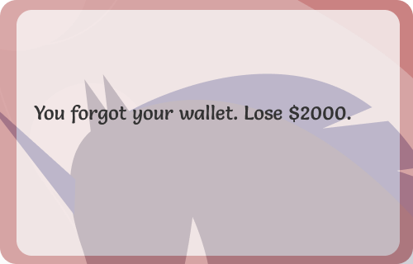
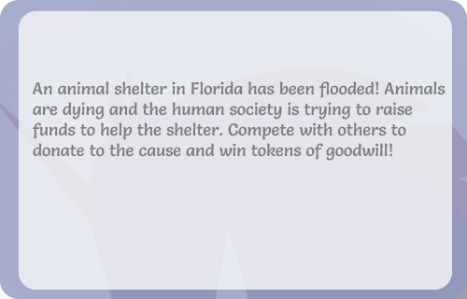
Prototype Four: Materials
Event Cards
Auction Cards

Slide 18
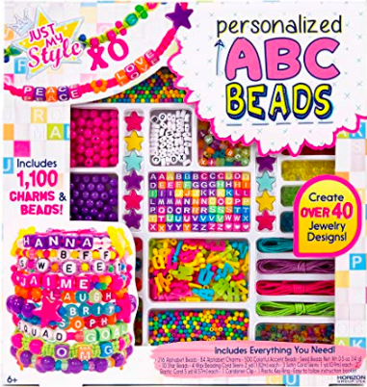
Prototype Four: Materials
Beads

Slide 19
Prototype Four: Playtest
Feedback
There were players at the end who didn’t get enough beads to make anything. Players would like to get more beads throughout the process.
Players felt there were too many pitch cards where everyone had to give a speech.
Players felt there needs to be a time limit on the auction process.

Slide 20
Final Prototype: Design
Feedback 1: There were players at the end who didn’t get enough beads to make anything. Players would like to get more beads throughout the process.
We changed the number of beads that everyone gets to 5, 3, 2, 1 for first place to fourth place respectively. Hence every player will get at least 6 beads in the end (there are six auction cards in total)
Feedback 2: Players felt there were too many pitch cards where everyone had to give a speech.
We took out some pitch cards from the pile to make it fewer.
Feedback 3: Players felt there needs to be a time limit on the auction process.
We limited the auction time to 10 seconds before players have to make their mind.
Feedback 4: Players felt the special ability cards were confusing.
We removed the special ability cards.

Slide 21
Final Prototype: Elements
Dice
Chance cards
+
+
-
Quiz cards
Money
Auction cards
-
+
-
+
+
Donor one
+
Organization Two
Reasons
Token
+
Benefit
+
Reasons
-
Prevent
Organization One
+
Loosely connected (not in the strong
competition mode)
Donor two

Slide 22
Final Prototype: Rules
Each player is a donor, and each player starts with $ 10,000. Throughout the game, there will be multiple instances to donate money in exchange for beads. Whoever has the most beads when the game ends wins!
Each player takes turn drawing a card. He/she needs to read the card out loud.
Different types of chance cards:
Auction: Players have a silent bidding section, the highest bidder gets 5 beads, second and third highest gets 3 and 2 beads, fourth gets 1.
Players have 10 seconds to decide the amount of money they want to donate.
Players hide how much money they’re going to donate, and when 10 seconds are up, each player reveals the amount that they’re going to bid.
After each silent auction, each player rolls the die to replenish money from the bank. Each player gets the amount of money that’s equivalent to the number that they got on the die * 1000 (e.g., for the player rolled a 6 on the die, he gets 6*1,000 = $6,000 from the bank)
Event: Players follow event instructions listed on the cards. These include events which, for instance, make one or all players lose or gain money.
Quiz: there’s a question with multiple choice. Each player gives their answer at the same time. Whoever got the correct answer gets a bead. There is an answer sheet to the questions.
The game ends when all the auctions card runs out and the player that has the most beads win!
At the end of the game, each player could use the beads they have to make anything they want.

Slide 23
Final Prototype: Materials
Event Cards
Auction Cards

Slide 24
Final Prototype: Materials
Beads

