Slide 1
Process Book
Project 4: CUI for Autonomous Vehicles
Team 5: Eileen Mao, Junhui Yao, Scarlet Tong, Sprina Wu
IxDo | Section A | Instructors: Karen Kornblum Berntsen, Marysol Ortega Pallanez, Paul Pangaro | Fall 2019

Slide 2
Table of Contents
03
-
09
10
-
15
16
-
17
18
Initial Draft of Setting Context, Scope of CUI and Script
First draft of the scenario and basic script for the project. Including purpose of the trip, the passenger's internal state, and external context.
Revised Setting Context & Scope of CUI
The team reframed the scenario and passenger profile for the project.
Revised Script & VoiceFlow
Begin to develop the final CUI and thinking about how to transition between the different events.
Reflections
Team reflections towards the project.
Notes:
Junhui: There are changes in the page number.

Slide 3
Initial Draft of Setting Context & Scope of CUI
It’s an important night for Michael as he is on his way to the Benedum Center for a date.
TRIP DETAILS
Pickup Location: Carnegie Mellon University
Destination: PNC Broadway in Pittsburgh (BENEDUM CENTER)
EXTERNAL CONDITIONS
Heavy Snow (High Traffic)
Did not have time to prepare for the date
INTERNAL CONDITION + GOALS
Nervous and worried
Want to leave a good impression
PASSENGER PROFILE
Michael is a 25-year-old engineer working at Carnegie Mellon University. He recently gets to know a girl and plan to hang out with her watching Les Miserables. He really likes the girl but has no time for arranging things including gifts and restaurants.
In addition, he is really nervous. During this trip, he plans to stop by a flower shop and do research about the nearby restaurants. In addition, he would like to know more about Les Miserables. On a snowy day, he took an autonomous vehicle.

Slide 4
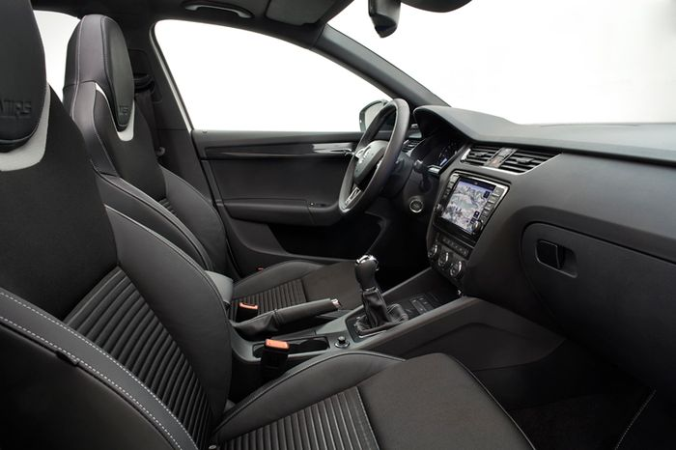
Role of the In-Vehicle CUI
Our CUI is focused on ensuring that the user has an enjoyable ride by identifying the user’s needs and helping to ease any problems identified.
In our scenario, the CUI identified that Michael was nervous about his date. It then proceeded to help ease his emotions and aid in preparing him for his date by helping him buy a gift, place a reservation, and familiarize himself with a musical.
Notes:
Feel free to change anything - Sprina

Slide 5
First Drafts of Conversational Interactions and Script
Date Night Prep Talk (Scarlet)
B: Bot M: Michael
B: So are you watching the show with anyone?
M: Well, I guess you can say she is someone special.
B: Let me guess, are you going on a date?
M: Haha… yea
B: Do you know what is most important on a date?
M: I don’t know. Leave a good impression?
B: Actually, it’s all about being yourself and paying attention to the details.
M: What do you mean by that? OR Can you elaborate more on that?
B: Start with a subtle cologne that is not too overpowering, especially when you don’t want to take away from the
show.Use other senses to your advantage, such as smell and hearing to set up a mood.
M: Hm…. well do you have any suggestions on how I should act?
B: Definitely you should take it slow and not give too much of yourself at once so that she will want to get to know you
better. If you try to be someone you are not, it will only generate a false impression for her. Of course, you should
show equal amounts of attention and always be tentative to her. This will help portrait you as more dependable and
reliable. Do you think you can do it?
M: I’m not sure.
B: I am confident that you will do great.
Notes:
Change table of contents title

Slide 6
First Drafts of Conversational Interactions and Script
Buying a Gift (Junhui)
B = Bot, M = Michael
B: Hi, Michael. How are you today?
M: Good. Could you help me find the nearest flower shop?
B: Sure.
B: Here are three recommendations. No.1 Squirrel Hill Flower Shop 0.8mi No.2 Gidas Flowers 1.8mi No.3 Alex’s East
End Floral Shoppe 2.2mi. Which one do you prefer?
M: Squirrel Hill Flower Shop sounds nice. Could you help make a call?
B: Of course. Ding…… (talking with a saleslady)
M: Thank you. Let’s go to Squirrel Hill Flower Shop to pick up the flower.
B: The flower will be ready after 30 min. And it will only take 5 min to get there. Would you like to do something else
before going to the flower shop?
M: Oh, right. I did not notice that. Do you have any recommendations?
B: How about listening to some music from Les Miserables ?
M: Sure. Thanks.
B: My pleasure.
Notes:
Change table of contents title

Slide 7
First Drafts of Conversational Interactions and Script
Playing Music (Sprina)
B: Bot M: Michael
B: Hello Michael, I noticed that you are headed towards PNC Broadway. What show are you planning to watch?
M: Les Miserables.
B: Sounds fun, are you familiar with the songs?
M: No, I am not.
B: Oh, would you like to listen to a Les Miserables playlist to familiarize yourself?
M: Sure.
B: Sounds good. (Plays music)
Notes:
Change table of contents title

Slide 8
First Drafts of Conversational Interactions and Script
Restaurant recommendations (Eileen)
B: Bot M: Michael
M: Hey, so after the show I was thinking that I should grab dinner with the girl.
B: That sounds like a great idea!
M: Do you have any restaurant recommendations?
B: There are many good food places in Pittsburgh, do you have any preferences on location?
M: I would like a restaurant near the Benedum Center where our show is playing.
B: Okay, do you have any food genre preferences?
M: I remember the girl told me she really likes italian food. So we could get that.
B: Sienna Mercato, Molinaro Restaurante and Bar, are popular italian restaurants near the Benedum Center.
M: Which one has the highest ratings?
B: Out of the three, Sienna Mercato has 4.4 stars, and Molinaro Restaurante has 4.3 stars.
M: I guess I want to go to the one that has the highest ratings, I want to have the perfect dinner with this girl and then if
everything goes well ask her out officially at the end.
B: Sounds good! What time do you want to make your reservation?
M: 7:30 pm should be okay.
B: I am going to make a reservation at Sienna Mercato for two at 7:30. Does that sound good?
M: Yes.
B: (Calls restaurant to make reservation) The reservation has been made. Hope you enjoy your dinner.
M: Thank you so much!
Notes:
Change table of contents title

Slide 9
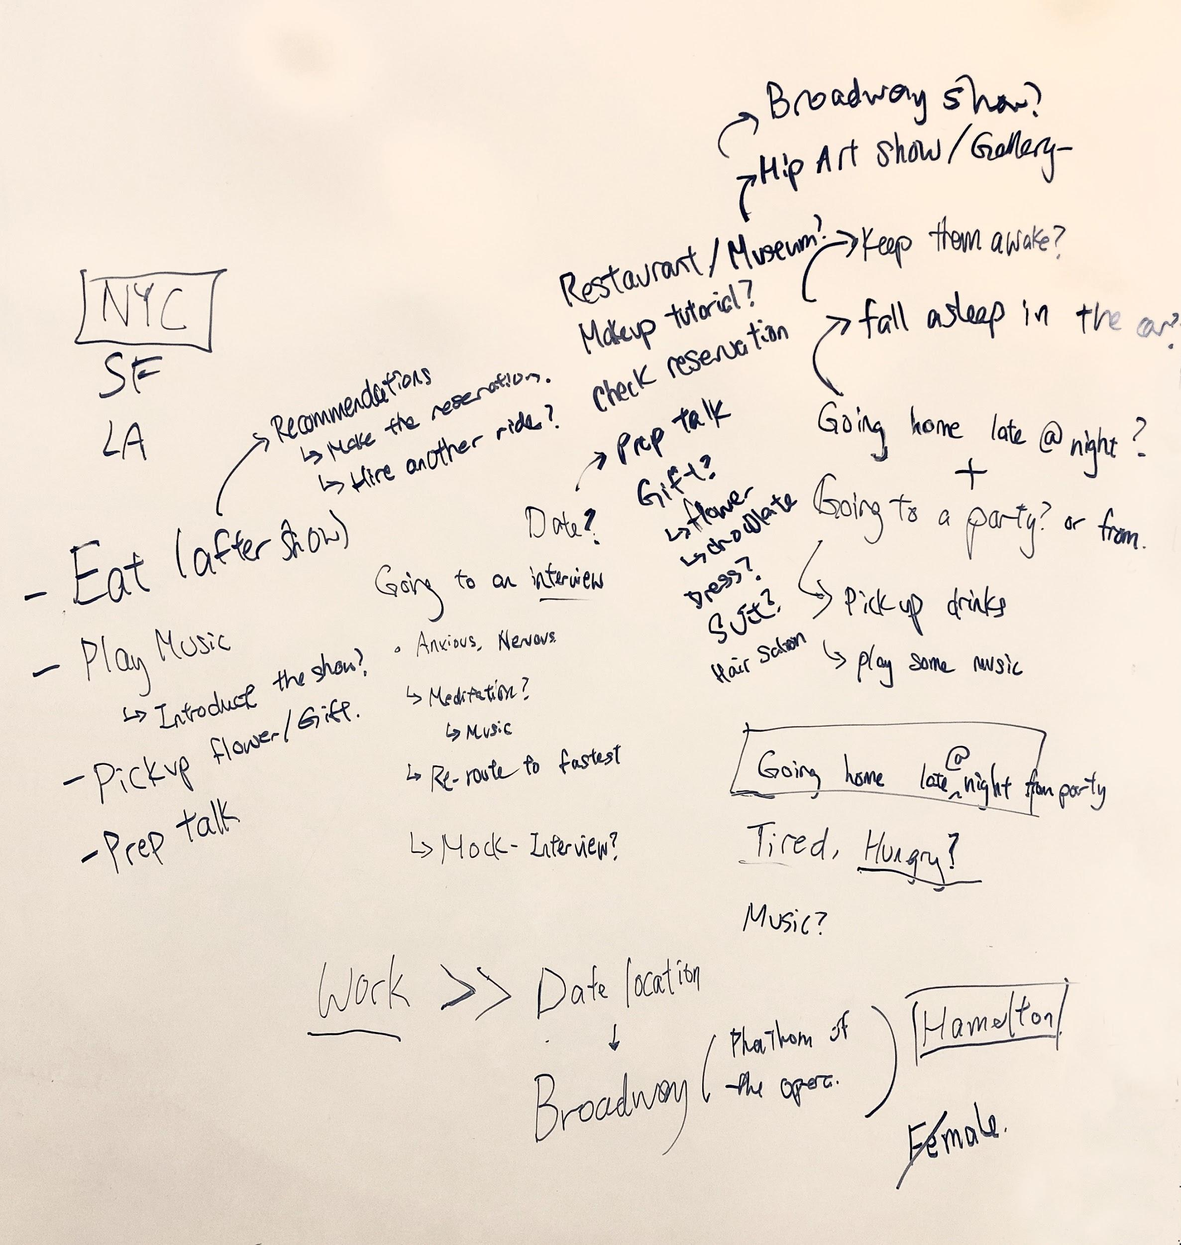
Revised Setting Context & Scope of CUI
The team decided to change the narrative for the project to create a more captivating and believable scenario. The team decided to base the scenario in New York City and a passenger named Michael who works as a Healthcare Investment Banking Associate in New York City. We also aimed to create more “open-ended” conversation between the AI and passenger by integrating the conversation perspectives introduced in class. The key is to take advantage of the shared location information to offer more collaborative experience.
We drafted how the four events will take place throughout the ride:
1. Addressing emotional concern
Help Michael feel calmer and confident about the date.
2. Getting a Gift
Help Michael pick out and buy a gift for his date.
3. Planning Restaurant Plans
Assist Michael in picking a restaurant to go after the show.
4. Cueing Music
Select music to prepare Michael excited and confident for the date.
Notes:
Change table of contents title

Slide 10
Revised Setting Context & Scope of CUI
Addressing emotion concern
Help Michael feel calmer and confident about the date.
Getting a Gift
Onboarding
Help Michael pick out and buy a gift for his date.
Drop-off
Ryde picks up Michael from his house.
Safely drop off Michael at Broadway
Planning Restaurant Plans
Assist Michael in picking a restaurant to go after the show.
Cueing Music
Select music to prepare Michael excited and confident for the date.

Slide 11
Revised Passenger Profile
Meet Michael
He is a Healthcare Investment Banking Associate in New York City. Despite his busy schedule, he loves to enjoy the cultural entertainment NYC have to offer, such as unconventional art galleries, broadway shows, etc. He aims to bring his career success into his relationship life too as he searches for his partner.

Slide 12
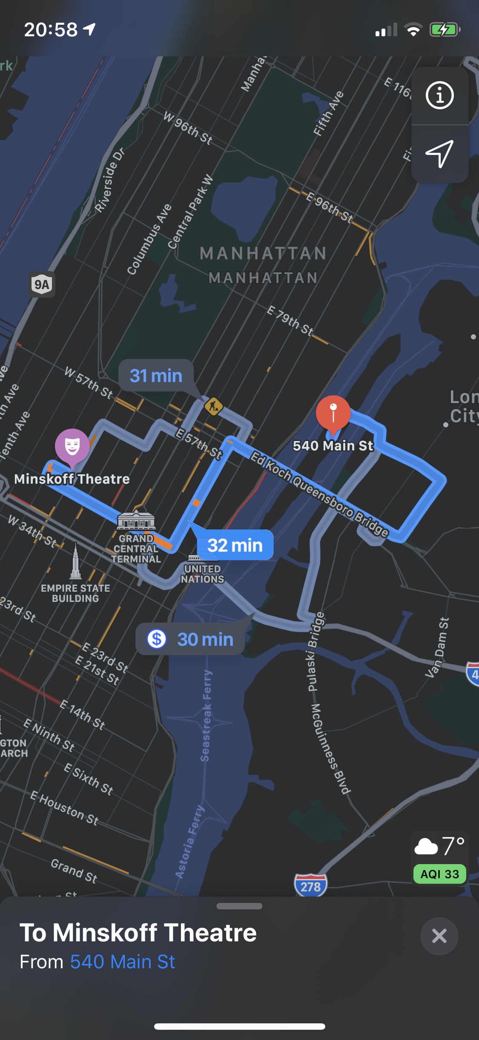
Revised Setting Context & Scope of CUI
Trip Details
Scenario
From: Home (APT1324 540 Main st Roosevelt Island)
To: Broadway (Minskoff Theatre)
Purpose of the trip: A date
The passenger's internal state:
Emotional: Anxious and excited.
Physical: He may fidget and stutter his words.
Cognitive: He doesn’t want to mess up the date.
External context:
Traveling during rush hour, but did not have time to prepare much for the date.
It is very snowy outside.
Situational conditions:
Wants to buy flowers for his date
Needs to plan dinner restaurant recommendation
He is also very nervous because he is hoping to give a good impression on their first date.
Michael is a 25-year-old banker working on Wall Street. He recently got to know a girl and plans to hang out with her by watching Hamilton. He really likes the girl but has no time for arranging things including gifts and restaurants. In addition, he is really nervous.
During this trip, he plans to stop by a flower shop and do research about the nearby restaurants. In addition, he would like to know more about Hamilton. On a snowy day, he took an autonomous vehicle.
Notes:
Change table of contents title

Slide 13
Revised Script
Introduction (B: Bot, M: Michael)
B: Hi Michael. Thank you for requesting my service. The trip is expected to take 32 minutes. We will arrive at Minskoff
Theatre by 6:04pm.
B: Is the temperature of the car comfortable for you?
M: Can you turn up the heater? It’s really cold outside
B: Certainly. It is getting really cold these days, especially with the heavy snow today. *cue in heater sound* Here you
go, the thermostat is now on 72 degrees, it should get you nice and cozy in no time.
Calming down nerves (Scarlet)
Intents: [date], [emotion], [gift],
Utterances:
B: So, are you going to watch a show tonight at the
Minskoff Theatre?
M: Yea, I got tickets to watch the Hamilton tonight.
B: Are you going alone?
M: No.. I’m going with someone special.
B: Let me guess, are you going on a date?
M: Um...yea
B: Why the hesitation?
M: Well, it’s kinda embarrassing, but I very nervous.
B: What is making you feel nervous?
M: That’s because I really like her and I don’t want to mess
up. I am not sure how to act or present myself. I don’t
want to give a bad impression.
B: I have some suggestions. Maybe you will be less
nervous if you didn’t go to the date empty-handed
[lead to gift conversation]. Or I can play some comedy
to help lighten the mood.
M: Would getting a gift affect our arrival time?
B: Based on current traffic information, there will be less
traffic after we cross the bridge and we will be able to
make a quick stop so that we will get to Minskoff
Theatre by 6:15. What do you think?
Slots: <emotion>, <gift>, <humor>
Notes:
Change table of contents title

Slide 14
Revised Script
Buying gifts (Junhui)
Intents: Buying gifts Slots: <Flower places>, <music>
Utterances:
B: What kind of gift do you have in mind?
M: Hm… I guess we can get her flowers?
B: Sounds good, here are three flower shops that is on our way: Eva’s Garden Florist, ArtsyFlora Floral Boutique, Rosa
Rosa Florist. I can drive by those shops, and let you check them out?
M: Sounds like a plan.
B: Michael, here we have Eva’s Garden Florist on the right. Would you like to stop and take a look inside?
M: Um, sure.
B: I will be waiting for you here.
M: Alright, see you soon *leaves car*
M: I’m back. Sadly, they don’t seem to have anything that looks good. Can we go check out the other florists?
B: Sure, ArtsyFlora Boutique is just a few blocks down. What kind of flowers would you like to give to her?
M: I have no clue.
B: Right. How about giving her dried roses? That way her dress won’t get wet
M: Nice. Let’s do dried flowers. Thank you.
B: My pleasure. ArtsyFlora Boutique is just on your right. Would you like to go check it out for dried ones?
M: Yea
M: *Michael returns* Awesome, I bought a small bouquet of dried roses. Now let’s make our way to the theatre.
B: Great. We are ten minutes away. Are you feeling better now?
M: Much better. Thank you.
Notes:
Change table of contents title

Slide 15
Revised Script
Playing Music (Sprina) (Collaborating)
Intents: Playing music, preparing Michael for his date
Utterances:
B: Are you familiar with the Hamilton musical?
M: No, how should I familiarize myself with it?
B: Would you like to listen to the Hamilton soundtrack?
M: Sure, what playlist should I listen to?
B: I can play the most popular songs, the chronological list, or I could play specific songs.
M: I’ll listen to the most popular songs.
B: Sounds good. -Plays music-
Slots: What playlist to play, whether or not to play music, what musical Michael is going to watch
Notes:
Change table of contents title

Slide 16
Revised Script
Booking a Restaurant (Eileen )
Intents: Lookin at restaurants, suggesting restaurants
Utterances:
M: Hey, so after the show I was thinking that I should grab
dinner with the girl.
B: That sounds like a great idea!
M: Do you have any restaurant recommendations?
B: There are many good food places in NYC, do you have
any preferences on location?
M: I would like a restaurant near the Broadway where our
show is playing.
B: Okay, do you have any food genre preferences?
M: I remember the girl told me she really likes Italian food.
So we could get that.
B: According to maps, Sienna Mercato, and Molinaro
Restaurante and Bar, are all italian restaurants that
happen to be on the way to the show. The detour will
only add 7 extra minutes to your trip. Would you like to
drive past these restaurants to check them out?
M: Sure, I want to see how they look. It is important that the
restaurant vibe is fitting.
B: Okay! We will drive past the three in order of closest to
farthest.** Drives past all three **
M: Seems like Sienna Mercato is the most well lit, and it even
had a live jazz band playing inside and a beautiful fountain
outside it. I will choose that restaurant.
B: Sounds good! What time do you want to reserve a table for?
M: 7:30 pm should be okay.
B: I am going to make a reservation at Sienna Mercato for two
at 7:30. Does that sound good?
M: Yes.
B: *Calls restaurant to make reservation*
B: The reservation has been made. Hope you enjoy your dinner.
M: Thank you so much!
Slots: Cuisine, distance of food from a certain destination, time of reservation, number of people to reserve for.
Notes:
Change table of contents title

Slide 17
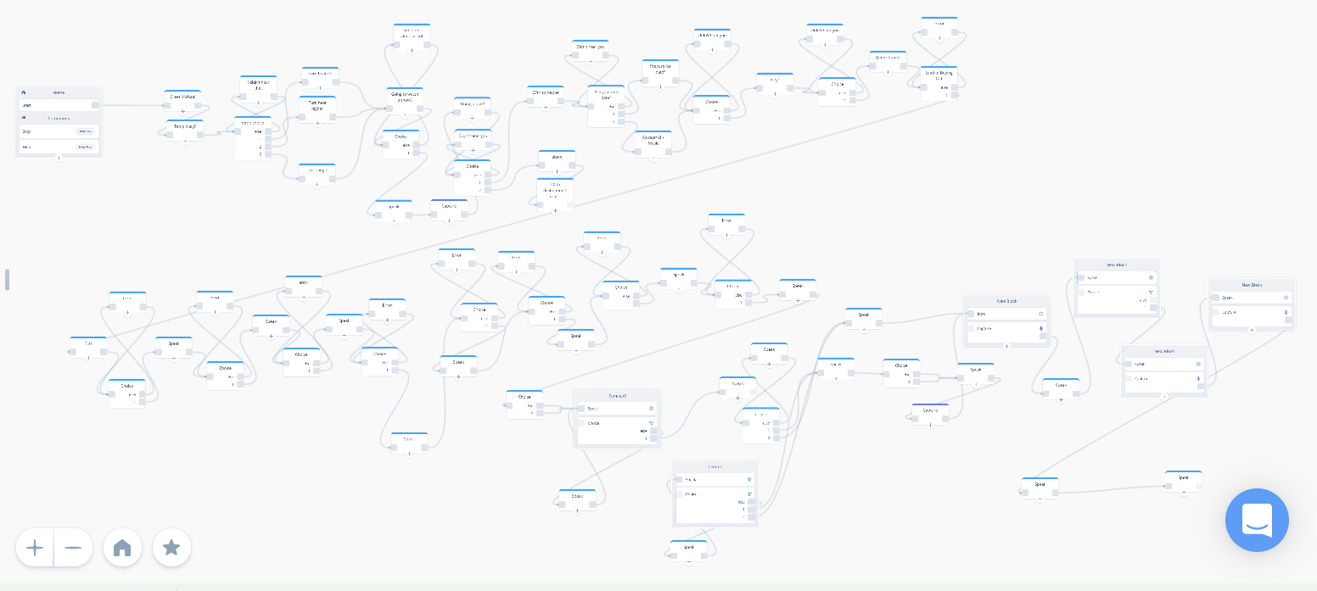
Voice Flow
Notes:
Change table of contents title

Slide 18
Reflections
Eileen Mao
Coming into this class I always thought of UX to be some sort of visual interface, which was also demonstrated in the first three projects. However, working on a CUI made me realize that a user's experience can come in many different forms, with voice being a relatively new technology. It was very interesting to work on this new dimension of user experience, even though the process of creating it was the same as any other type of design (starting with research, testing, critiques, and final draft). Although we made a CUI, I look forward to exploring this topic in more depth with AI and security.
Junhui Yao
CUI is an emerging field which liberates people’s eyes. Immersing in this project and crafting the dialogue (goals and means) are fun. It’s my first time creating a voice agent. The delivery of audio info differs from the visual ones. Also, this project seems to humanize the agent and create emotional empathy for riders. However, it makes me ponder the fine line of knowing users and invading the privacy.
Scarlet Tong
This project has introduced a new user experience medium on top of the usual user experience interfaces. It was very hard to implement ideas of “Designing for Conversation” into the CUI as it was my first time thinking about an auditory experience compared to the the conventional interfaces that are so visually dominate. This project sparks interest to this new emerging area of focus in HCI, and I hope to partake in paving new findings and research to advance our understanding of conversation and how we can translate it into CUI.
Sprina Wu
I had never worked with CUIs before or have given them much thought. This project introduced me to this idea and taught me about the complexities of the field that I otherwise would not have learned. I believe it was a valuable experience. I also really enjoyed our scenario idea which made the project very pleasant. I am still somewhat skeptical of the depth of capability with CUIs given the amount of data that they need to make decisions quickly but it is definitely an emerging field that is quickly growing.
Notes:
Change table of contents title

